Slide 1

Smart Classroom Monitoring System
Automated Attendance, Environmental Monitoring, and Energy Optimization
An intelligent IoT-based solution for centralized classroom management
ELURU SAI TEJA
323129520053

Slide 2

Problem Statement
Time-Consuming Attendance
Traditional attendance methods are slow, error-prone, and consume valuable instructional time.
Manual Monitoring Burden
Continuous human effort is required to observe and manage classroom environmental conditions.
Energy Wastage
Unnecessary usage of lights and fans leads to significant and avoidable electricity consumption.
Lack of Intelligent Systems
Institutions lack centralized, automated tools to monitor resources and improve utilization efficiently.

Slide 3
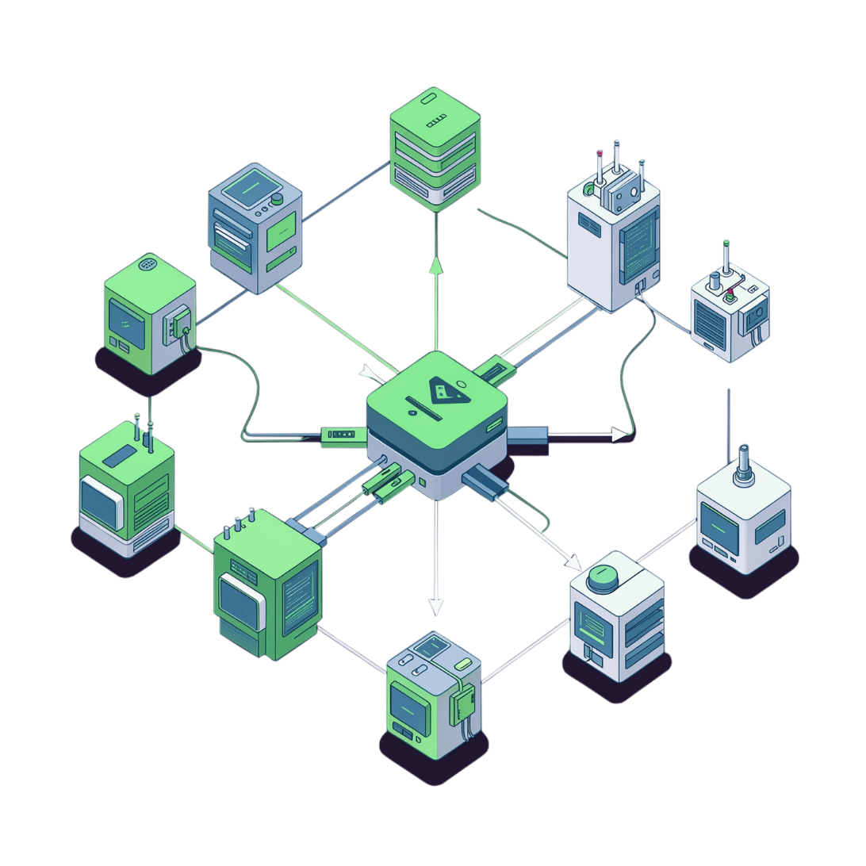
Proposed Solution
An integrated IoT-based Smart Classroom Monitoring System that unifies attendance, environment, and energy management into a single intelligent platform.
Automate student attendance using RFID or facial recognition
Monitor temperature, humidity, air quality, lighting, and classroom occupancy
Automatically control lights and fans based on occupancy and environmental conditions
Provide centralized monitoring through a secure and user-friendly platform

Slide 4
Key Objectives
Automated Attendance
Real-Time Monitoring
Improve recording accuracy and eliminate manual roll calls.
Track environmental conditions continuously across all classrooms.
Occupancy Detection
Energy Reduction
Detect and track the number of people present in each classroom.
Reduce unnecessary electricity consumption through intelligent automation.
Centralized Access
Reports and Insights
Provide administrators unified access to all classroom information.
Generate attendance and energy-consumption reports for data-driven decisions.

Slide 5
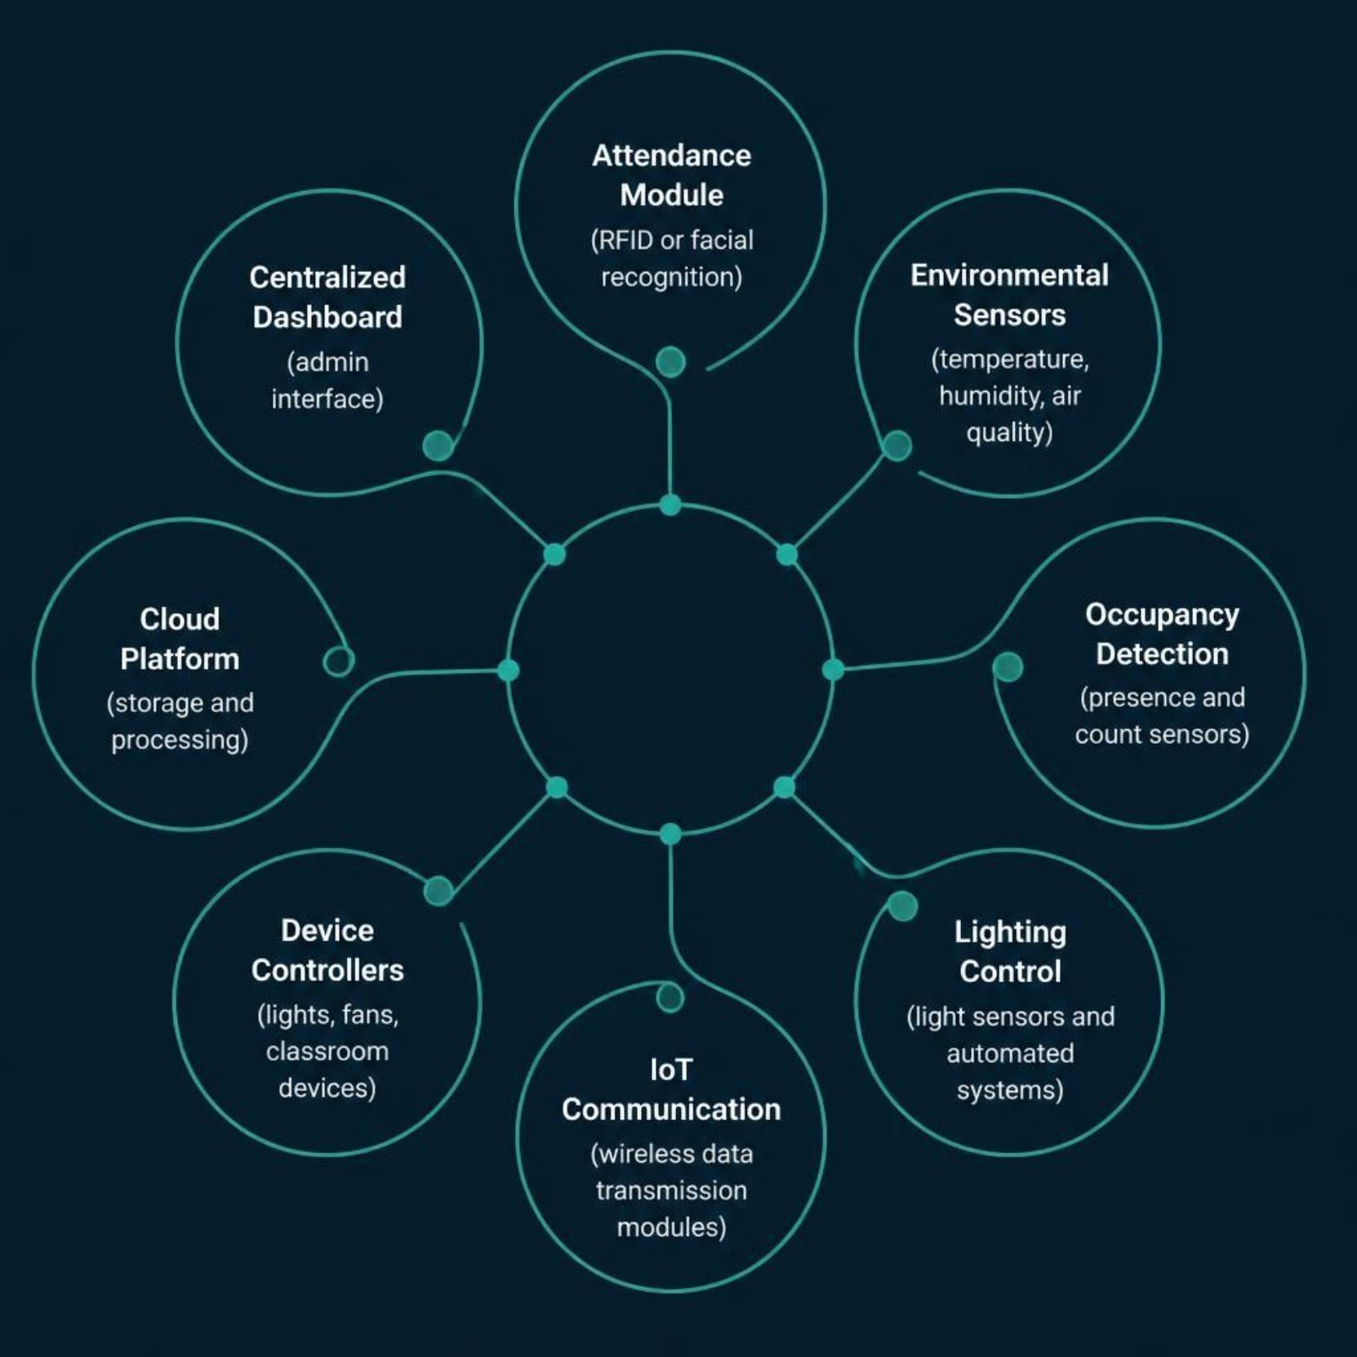
System Components
Attendance Module
RFID reader or facial recognition for automated student identification.
Environmental Sensors
Temperature, humidity, and air quality monitoring devices.
Occupancy Detection
Sensors to detect presence and count of people in the classroom.
Cloud Platform & Dashboard
Cloud-based storage, processing, and a user-friendly admin interface for centralized management.

Slide 6

System Working
IoT Transmission
Entry & ID
Students enter and are identified
Modules send data to the platform
Sensor Capture
Analysis & Control
Occupancy and environment recorded
System analyzes and auto-controls devices
The system operates as a seamless end-to-end pipeline — from student entry and identification through sensor data collection, intelligent analysis, automated device control, and finally centralized reporting for administrators.

Slide 7
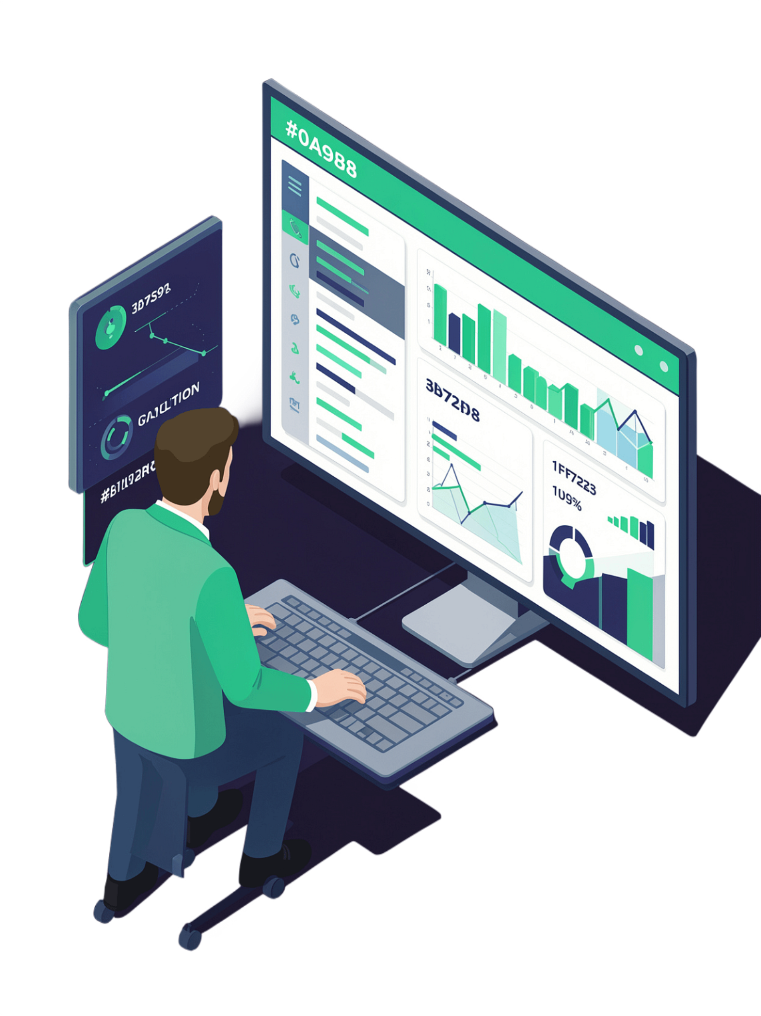
Dashboard and Monitoring
📋 Attendance Records
Student attendance logs and comprehensive historical reports.
🌡️ Environmental Data
Real-time temperature, humidity, and air-quality information.
⚡ Energy Metrics
Energy consumption tracking, trends, and analysis.
🔔 Alert Notifications
Automated alerts for anomalies and critical classroom conditions.
Administrators leverage real-time information to improve classroom management, optimize resource utilization, and make confident data-driven decisions.

Slide 8
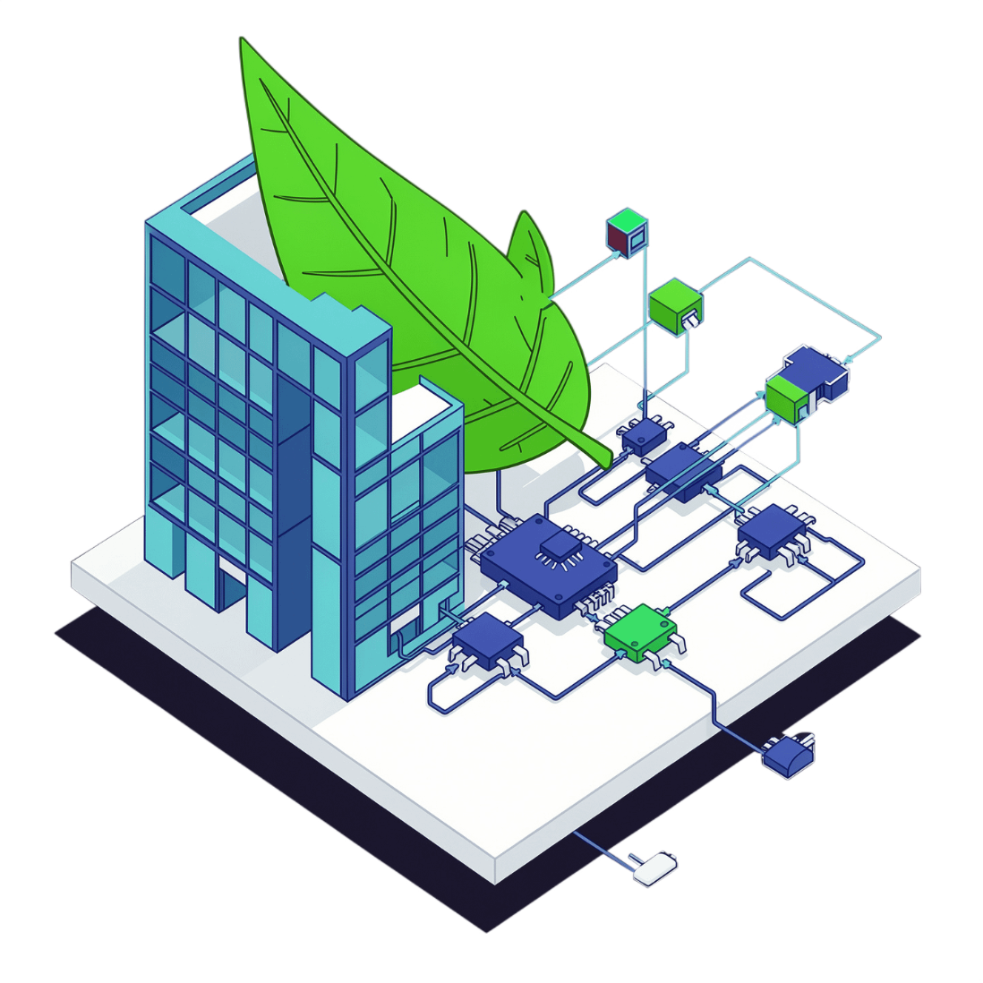

Energy Optimization and Environmental Monitoring
The system continuously analyzes occupancy and sensor data to drive intelligent, automatic control of classroom devices — eliminating waste and maintaining comfort.
Prevent unnecessary operation of lights and fans using occupancy data
Respond to ambient lighting conditions via light sensor readings
Continuously monitor temperature and humidity for optimal comfort
Enable automatic device control based on real-time conditions
Support efficient and sustainable classroom operations
Intelligent automation maintains a more comfortable and productive learning environment while significantly reducing electricity wastage.

Slide 9
Benefits, Security, and Scalability
Operational Benefits
Energy Efficiency
Accurate automated attendance, reduced manual effort, real-time monitoring, and an improved learning environment.
Lower electricity consumption, better resource utilization, and sustainable day-to-day operations.
Security
Scalability
Secure monitoring platform with controlled access and robust data protection measures.
Suitable for multiple classrooms across schools, colleges, universities, training centers, and entire smart educational campuses.

Slide 10
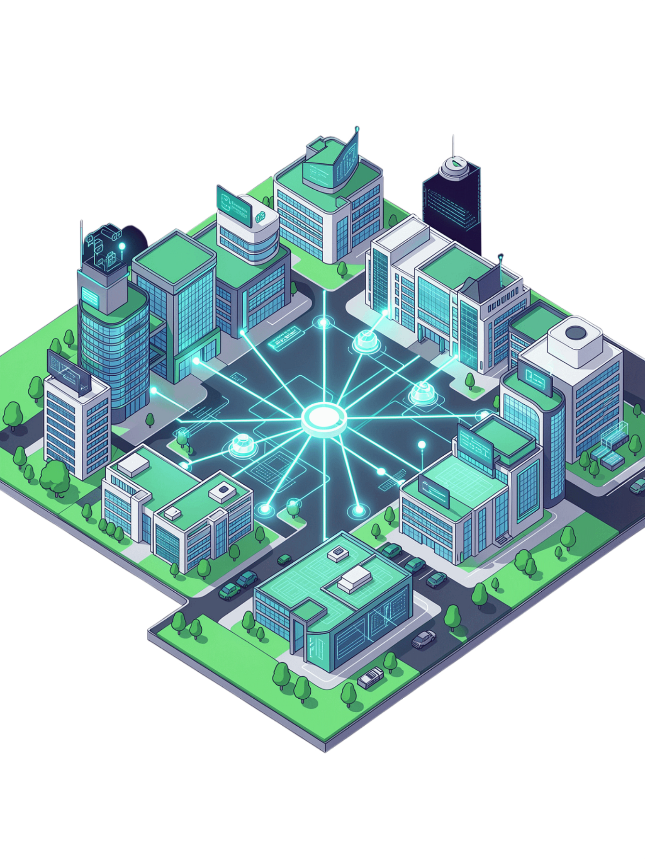
Conclusion and Future Impact
The Smart Classroom Monitoring System is a modern IoT-based solution that integrates automated attendance, environmental monitoring, and energy optimization into a unified, intelligent platform.
Efficiency
Intelligence
Improves classroom operations and reduces energy consumption.
Enables better decision-making through real-time data and analytics.
Transformation
Contributes to smart education and digital transformation in institutions.
Vision: Creating intelligent, efficient, secure, and sustainable educational campuses for the future.

